Slide 1


True Zeros, Missing Values and by-catch in the RDBES
(an intro to tables SL and SLDetails, and to “stratification” variables in all selection tables)
Nuno Prista,
Department of Aquatic Resources, SLU, Sweden
ICES WKRDBES-INTRO3, 24/09/2024

Slide 2
Summary
Short intro to true zeros and missing values
1. The role of SL in differentiating true zeros and missing values
  in regular samples
  When species are mixed under a commercial names (e.g., in markets)
2. The role of SL, SS and FO combined in differentiating true zeros from missing values in different areas of the vessel
3. The role of stratification in differentiating true zeros from missing values in selection-related samples
4. Other types of non-response, failed sampling and refusals in RDBES
5. Features of RDBES related to by-catches
My objective will be to show the structure and functioning so you can more easily make
decisions on how to populate the SS table of RDBES

Slide 3
True Zeros vs. Missing Values
In the present RDB [and most national databases!] only positive events are generally recorded.
  i.e., if a taxon is not in the sample, it is not show up in DB records
Also, generally there is no easily accessible information on sampling objectives themselves, e.g.,
  It is frequently not readily known to data users which taxa/size-categories are targeted by observers during the sampling (and which ones are not)

Slide 4
True Zeros vs. Missing Values
Consequently, during data analysis and estimation it is generally impossible to distinguish between
  Samples with no record from a taxon/size-category but where a check for it was made: true absences (aka true zeros)
  Samples with no record from a taxon/size-category but where no check was made for it: presence is not unknown (aka missing values)
This ambiguity directly biases:
  Estimates of frequent species and incidental bycatches
  Estimates of species composition of national statistics
  Length composition of size-sorted stocks, discards of size-stratified fleets, etc.
The RDBES handles the above through specifications of Species Lists (SL table), FOobservationCode (FO table), SSobservationActivityType (SS table), Stratification and NAreason (in all selection-related tables)

Slide 5
1.
The role of SL in differentiating true zeros and missing values
  in regular samples
  When species are mixed under a commercial names (e.g., in markets)

Slide 6
Motivation example 1
  In country A observers sampled a taxon (e.g., cod) at-sea or onshore.
Field records and national database/RDB
Species | Kg | Number
Cod | 200 | 420
Typical questions from data users:
Was cod the only target species?
Were there any other species in the landing?
Are other not recorded taxa 0s or NAs?!

Slide 7
Motivation example 2
  In country A observers go to a market and sampled one landing. Scientific taxa are sorted into boxes with commercial names.
Field records and national database/RDB
Species | CatchCateg | Weight (kg) | SubSampWeight (kg)
Lophius piscatorius | Lan | 100 | 100
Typical questions from data users:
Are we sure there was no Lophius budegassa in the landing?
  i.e., Lophius budegassa == 0 kg
Or could it be that observers only aimed to sample Lophius piscatorius?
  i.e., Lophius budegassa == NA kg

Slide 8

How are these examples handled in RDBES
  At-sea sampling:
    what taxa did observers look for in the samples
      All species?
      Just the commercial species?
      Everything but invertebrates?
  At-market sampling:
    what taxa did the observers look for in the samples
      All species?
      Just the commercial species?
      Everything but invertebrates?
    Were the taxa or commercial names what was sampled?
The RDBES handles this issue using
two tables
- “Species Selection” (SS)
- “Species List Details ”(SL)
Combined with Sample table (SA)
RDBES Data Model CS.xlsx [in GitHub]
RDBES Data Model VD SL.xlsx [in GitHub]

Slide 9
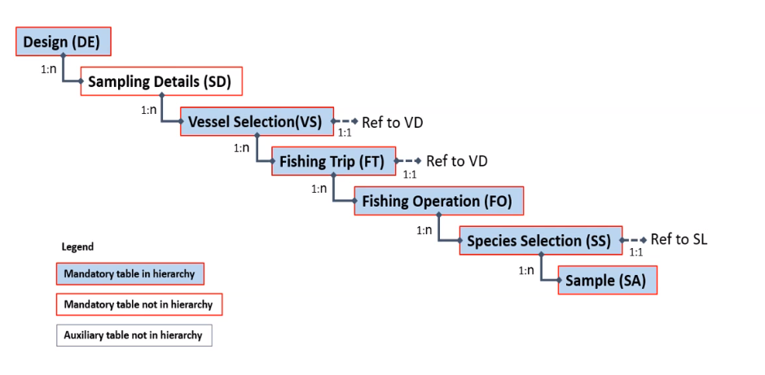
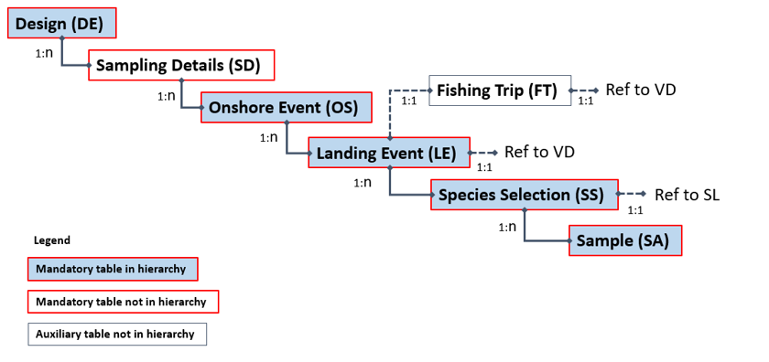
At-sea sampling
Onshore sampling

Slide 10
Recall: Motivation example 1
  In country A observers sampled a taxon (e.g., cod) at-sea or onshore.
Field records and national database/RDB
Species | Kg | Number
Cod | 200 | 420
Typical questions from data users:
Was cod the only target species?
Were there any other species in the landing?
Are other not recorded taxa 0s or NAs?!

Slide 11
How RDBES will differentiate true 0s and NAs
Field records and national database/RDB
Species | Kg | Number
Cod | 200 | 420
RDBES (SA table)
RDBES (during estimation)
Species | Kg | Number
Cod | 200 | 420
Species | Kg | Number
Cod | 200 | 420
Plaice | 0 | 0
Undulate ray | 0 | 0
Thornback ray | 0 | 0
Black-headed gull | NA | NA
Harbour porpoise | NA | NA
+
Spp List (SL via SS)
Cod
Plaice
Undulate ray
Thornback ray
True 0s
NAs

Slide 12
Recall: Motivation example 2
  In country A observers go to a market and sampled one landing. Scientific taxa are sorted into boxes with commercial names.
Field records and national database/RDB
Species | CatchCateg | Weight (kg) | SubSampWeight (kg)
Lophius piscatorius | Lan | 100 | 100
Typical questions from data users:
Are we sure there was no Lophius budegassa in the landing?
  i.e., Lophius budegassa == 0 kg
Or could it be that observers only aimed to sample Lophius piscatorius?
  i.e., Lophius budegassa == NA kg

Slide 13
How RDBES will differentiate true 0s and NAs
Sample (SA):
SAsequenceNumber | SAparentSequenceNumber | Species / Species code | CatchCateg | Weight (kg) | SampWeight (kg)
1 |  | Lophius (125802) | Lan | 500 | 100
2 | 1 | Lophius piscatorius (126555) | Lan | 100 | 100
Taxon sampled at
market
Taxon identified by
observers
+
Taxon being sampled at market
Species List (SL via SS):
Taxon identified by
observers
SLid | SLcatchFraction | SLcommercialTaxon | SLspeciesCode
1 | Lan | Lophius (125802) | L. budegassa (126554)
2 | Lan | Lophius (125802) | L. piscatorius (126555)
3 | Lan | Lophius (125802) | Lophius (125802)
RDBES (during estimation)
SAsequenceNumber | SAparentSequenceNumber | Species / Species code | CatchCateg | Weight (kg) | SampWeight (kg)
1 |  | Lophius (125802) | Lan | 500 | 100
2 | 1 | Lophius piscatorius (126555) | Lan | 100 | 100
3 | 1 | Lophius budegassa (126554) | Lan | 0 | 0
4 | 1 | Lophius (125802) | Lan | 0 | 0
added to SA during
estimation

Slide 14
If only Lophius piscatorius was in the sampling targets
Sample (SA):
SAsequenceNumber | SAparentSequenceNumber | Species / Species code | CatchCateg | Weight (kg) | SampWeight (kg)
1 |  | Lophius (125802) | Lan | 500 | 100
2 | 1 | Lophius piscatorius (126555) | Lan | 100 | 100
Taxon sampled at
market
Taxon identified by
observers
+
Taxon being sampled at market
Species List (SL via SS):
Taxon identified by
observers
SLid | SLcatchFraction | SLcommercialTaxon | SLspeciesCode
1 | Lan | Lophius (125802) | L. piscatorius (126555)
RDBES (during estimation)
SAsequenceNumber | SAparentSequenceNumber | Species / Species code | CatchCateg | Weight (kg) | SampWeight (kg)
1 |  | Lophius (125802) | Lan | 500 | 100
2 | 1 | Lophius piscatorius (126555) | Lan | 100 | 100
3 | 1 | Lophius budegassa (126554) | Lan | NA | NA
4 | 1 | Lophius (125802) | Lan | NA | NA
added to SA during
estimation

Slide 15
2.
The role of SL, SS and FO combined in differentiating true values from missing zeros in different areas of the vessel

Slide 16
Motivation example 3
  In country A observers go onboard a large gillnetter and sample discards. However, they work at a conveyor belt in the underdeck and do not observe the net coming in.
Field records and national database/RDB
Species | CatchCateg | Weight (kg) | SubSampWeight (kg)
Cod | Dis | 100 | 100
Typical questions from data users:
- Was any catch discarded on top-deck? Or that dropped out of the gear during hauling?
- Can one assume there were 0 dolphins in the net?! [= 0s] Or it is better not? [= NAs]

Slide 17
How is this example handled in RDBES
  where were catches looked for?
    In the sorted catches?
    Also on deck during net hauling/opening?
    Also during slipping events?
The RDBES handles this issue by combining the variables:
FOobservationCode (FO table),
SSobservationActivityType (SS table)
with information in
“Species List Details”(SL)
“Sample table” (SA)
RDBES Data Model CS.xlsx [in GitHub]
RDBES Data Model VD SL.xlsx [in GitHub]

Slide 18
    FOobservationCode – what parts of the fishing operation are observed
    SSobservationActivity – specific
    part of FO observed

Slide 19
Recall: Motivation example 3
  In country A observers go onboard a large gillnetter and sample discards. However, they work at a conveyor belt in the underdeck and do not observe the net coming in.
Field records and national database/RDB
Species | CatchCateg | Weight (kg) | SubSampWeight (kg)
Cod | Dis | 100 | 100
Typical questions from data users:
- Was any catch discarded on top-deck? Or that dropped out of the gear during hauling?
- Can one assume there were 0 dolphins in the net?! [= 0s] Or it is better not? [= NAs]

Slide 20
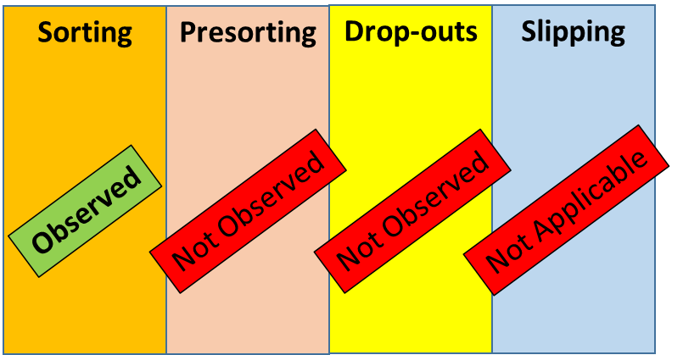
Conceptual analysis of example
  In country A observers go onboard a large gillnetter and sample discards. However, they work at a conveyor belt in the underdeck and do not observe the net coming in.
FOobservationCode / SSobservationActivityType
True 0s
NAs
Species list
NAs

Slide 21
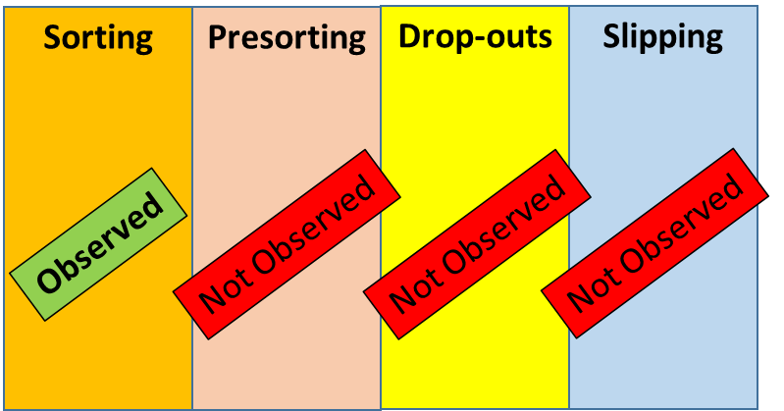
RDBES: capabilities to generate zeros and NAs
RDBES view [FO, SS, SL and SA combined]
Species | CatchCateg | SSobservationActivityType | Weight (kg)
Cod | Dis | Sort | 100
Plaice | Dis | Sort | NA
Dolphin | Dis | Sort | 0
Cod | Dis | Presort | NA
Plaice | Dis | Presort | NA
Dolphin | Dis | Presort | NA
Cod | Dis | Drop-outs | NA
Plaice | Dis | Drop-outs | NA
Dolphin | Dis | Drop-outs | NA
Cod | Dis | Slipping | NA
Plaice | Dis | Slipping | NA
Dolphin | Dis | Slipping | NA
Fishing Operation (FO):
FOid | ... | FOobservationCode | Observation code explained
1 | ... | So | Only Sorting observed
2 | ... | So | Only Sorting observed
... | ... | ... | ...
Species List (SL):
Species List A
Cod
Dolphins
Species Selection (SS):
SSid | Foid | ... | SSobservationActivityType | SScatchFraction | SSsppListName
1 | 1 | … | Sort | Dis | A
2 | 2 | … | Sort | Dis | A
... | ... | ... | ... | ... | ...
Note: Different SLs can be specified for different parts of the catch

Slide 22
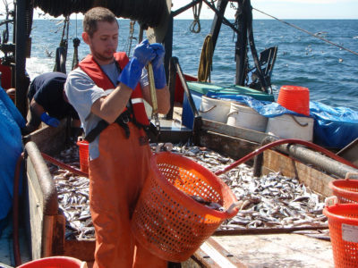
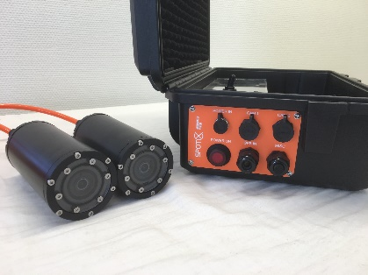
Other combinations of vessel areas are possible
  In country A observers go onboard a large gillnetter and sample discards at the conveyor belt in the underdeck. In the upper deck video footage of net hauling is collected. There is no observation of catch losses outside the vessel.
Sorting
Presorting
Drop-outs
Slipping
SL “observers”
Observed
Observed
Not Observed
Not Observed
True 0s
NAs
SL “Camera”
NAs
True 0s
NAs

Slide 23
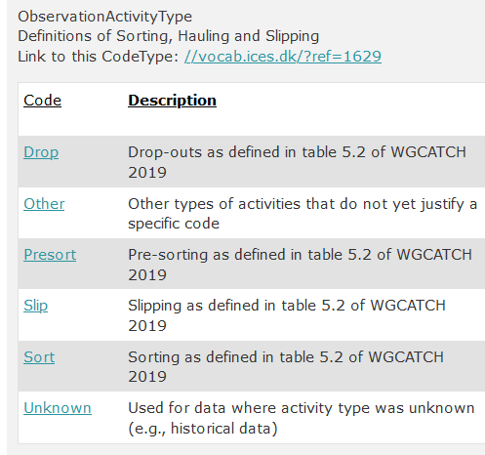
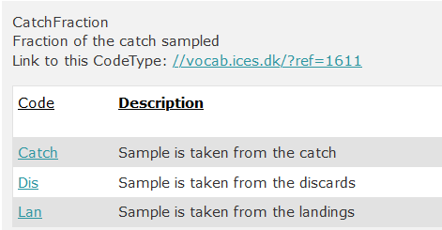
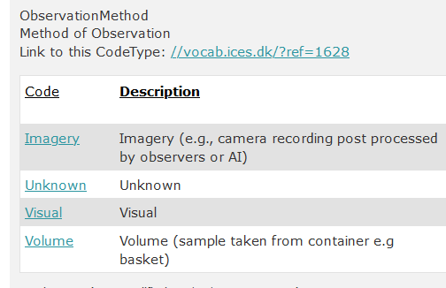
Different types of SLs
One can specify SLs:
  Per Observation activity type [Sort, Presort, etc.]
  Per Catch fraction [lan, dis, catch]
  Per Observation type [volume, visual, imagery]
  Combinations of the above
WGCATCH/WGBYC defined the terms for different fleets (gillnetters, trawlers, etc.)

Slide 24
3.
The role of stratification in differentiating true zeros from missing values in different selection-related tables
  Selection-related tables:
    Temporal event
    Location
    Vessel selection
    Fishing trip
    Fishing operation
    Onshore event
    Landing event
    Species Selection
    Sample
    …

Slide 25
Motivation example 5
  In country A n = 3 vessels are selected, n = 1 from stratum >15m and n = 2 from stratum <=15m.
View from national database/RDB
DateStart | DateEnd | Vessel id | Size (m)
11-06-2021 | 11-06-2021 | 1 | 19
12-06-2021 | 12-06-2021 | 2 | 14
12-06-2021 | 13-06-2021 | 3 | 12
Typical questions from data users:
Is this a random sample from population or was there stratification involved?!
Is the small size fleet being sampled? i.e., is <=10 in the programme?

Slide 26
Motivation example 6
  In country A observers go to a market and sample landing of cod sorted by size category (i.e., stratified by size category).
View from national database/RDB
Species | Size | Weight (kg) | SubSampWeight (kg)
Cod | 3 | 10 | 10
Cod | 4 | 50 | 50
Cod | 5 | 100 | 100
Typical questions from data users:
Are Cod size category 1 or 2 == 0 kg or NA? i.e., were sizes 1-2 really absent or just not sampled?
What about other possible sizes (e.g., 6?)

Slide 27
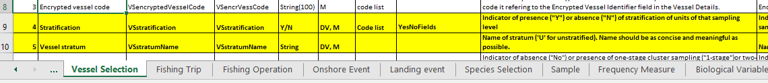
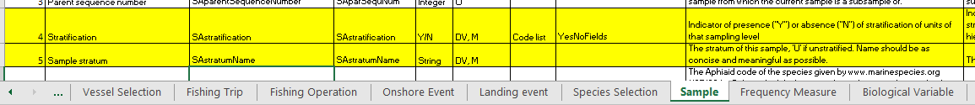
How are these examples handled in RDBES
  In all selection-related tables
    What stratification was used, anything there but out-of-frame?
      What fleets, type of trips, size categories were effectively targeted?
The RDBES handles this issue via its Design Variables (DV)
“XXstratification” & “XXstratumName”
Where XX = Table name
Vessel Selection table in RDBES Data Model CS.xlsx [in GitHub]
Sample table in RDBES Data Model CS.xlsx [in GitHub]

Slide 28
How are these examples handled in RDBES
New on RDBES: “when some components of the target population of each sampling level in RDBES are excluded from the sampling frame, they should be declared and, whenever possible, also quantified”
RDBES asks for all strata [within a parent sampling level] to be declared
  If we sample they will have samplesize>0, sampled == Y and child records in following tables
  If they were absent they will have samplesize = 0 and sampled == Y and no child records in following tables
  If we did not sample they will have a ”not-sampled” tag and a XXreasonNotSampled
This way:
  strata that were effectively absent will contribute with a 0 during estimation
  Strata that were present but not sampled will result in the parent mean/total being NA
Where XX = Table name

Slide 29
Recall: Motivation example 5
  In country A n = 3 vessels are selected, n = 1 from stratum >15m and n = 2 from stratum 10<=15m.
View from national database/RDB
DateStart | DateEnd | Vessel id | Size (m)
11-06-2021 | 11-06-2021 | 1 | 19
12-06-2021 | 12-06-2021 | 2 | 14
12-06-2021 | 13-06-2021 | 3 | 12
Typical questions from data users:
Is this a random sample from population or was there stratification involved?!
Is the small size fleet being sampled? i.e., is <=10 in the programme?

Slide 30
RDBES: capabilities to generate zeros and NAs
RDBES (VS table) – with random sampling
VSstratification | VSstratumName | VSencryptedVesselCode | VSselection method | VSnumTotal | VSnumSampled | SAsampled | SAreasonNotSampled
N | U | 1 | SRSWOR | 150 | 3 | Y
N | U | 2 | SRSWOR | 150 | 3 | Y
N | U | 3 | SRSWOR | 150 | 3 | Y
Compare with
RDBES (VS table) – with stratified random sampling
VSstratification | VSstratumName | VSencryptedVesselCode | VSselection method | VSnumTotal | VSnumSampled | SAsampled | SAreasonNotSampled
Y | >15m | 1 | SRSWOR | 50 | 1 | Y
Y | <=15m | 2 | SRSWOR | 100 | 2 | Y
Y | <=15m | 3 | SRSWOR | 100 | 2 | Y

Slide 31
RDBES: capabilities to generate zeros and NAs
RDBES (VS table) – with stratified random sampling
VSstratification | VSstratumName | VSencryptedVesselCode | VSselection method | VSnumTotal | VSnumSampled | SAsampled | SAreasonNotSampled
Y | >15m | 1 | SRSWOR | 50 | 1 | Y
Y | <=15m | 2 | SRSWOR | 100 | 2 | Y
Y | <=15m | 3 | SRSWOR | 100 | 2 | Y
Compare with
RDBES (VS table) – with stratified random sampling (but one fleet strata out of frame)
VSstratification | VSstratumName | VSencryptedVesselCode | VSselection method | VSnumTotal | VSnumSampled | SAsampled | SAreasonNotSampled
Y | >15m | 1 | SRSWOR | 50 | 1 | Y
Y | 10-<=15m | 2 | SRSWOR | 100 | 2 | Y
Y | 10-<=15m | 3 | SRSWOR | 100 | 2 | Y
Y | <=10m | “-9” | notApplicable | 1000 | 0 | N | OutOfFrame

Slide 32
Recall: Motivation example 6
  In country A observers go to a market and sample landing of cod sorted by size category (i.e., stratified by size category).
View from national database/RDB
Species | Size | Weight (kg) | SubSampWeight (kg)
Cod | 3 | 10 | 10
Cod | 4 | 50 | 50
Cod | 5 | 100 | 100
Typical questions from data users:
Are Cod size category 1 or 2 == 0 kg or NA? i.e., were sizes 1-2 really absent or just not sampled?
What about other possible sizes (e.g., 6?)

Slide 33
RDBES: capabilities to generate zeros and NAs
In RDBES the following situations will yield different end-results
SAid | SAcatch- Fraction | SAspecies- Code | SAstratum | SAcomm- SizeCat | SAselectionMethod | SAtotal | SAsample | SAsampled | SAreasonNotSampled
1 | Lan | 126436 | Size 1 | Size 1 | CENSUS | 1 | 1 | Y
2 | Lan | 126436 | Size 2 | Size 2 | SRSWOR | 5 | 2 | Y
3 | Lan | 126436 | Size 3 | Size 3 | SRSWOR | 10 | 2 | Y
4 | Lan | 126436 | Size 4 | Size 4 | SRSWOR | 30 | 2 | Y
Produces size distribution with all sizes [1,2,3,4]
SAid | SAcatch- Fraction | SAspecies- Code | SAstratum | SAcomm- SizeCat | SAselectionMethod | SAtotal | SAsample | SAsampled | SAreasonNotSampled
1 | Lan | 126436 | Size 1 | Size 1 | CENSUS | 1 | 1 | Y
2 | Lan | 126436 | Size 2 | Size 2 | SRSWOR | 5 | 2 | Y
3 | Lan | 126436 | Size 3 | Size 3 | SRSWOR | 10 | 2 | Y
Produces size distribution with all sizes [1,2,3]. Implicit that Size 4 was absent
Compare with
SAid | SAcatch- Fraction | SAspecies- Code | SAstratum | SAcomm- SizeCat | SAselectionMethod | SAtotal | SAsample | SAsampled | SAreasonNotSampled
1 | Lan | 126436 | Size 1 | Size 1 | CENSUS | 1 | 1 | Y
2 | Lan | 126436 | Size 2 | Size 2 | SRSWOR | 5 | 2 | Y
3 | Lan | 126436 | Size 3 | Size 3 | SRSWOR | 10 | 2 | Y
4 | Lan | 126436 | Size 4 | Size 4 | notApplicable | 30 | 0 | N | OutOfFrame
Produces size distribution NA during estimation

Slide 34
4. Other types of non-response, failed sampling and refusals
    Did we fail to sample something we wanted to sample?
The RDBES handles this issue via its Design Variables
“XXsampled” and “XXreasonNotSampled”
Where XX = Table name
VSid | VSselectionMethod | VsnumberTotal | VSnumberSample* | VSsampled | VSnoSampReason
1 | SRSWOR | 10 | 4 | Y
2 | SRSWOR | 10 | 4 | Y
3 | SRSWOR | 10 | 4 | Y
4 | SRSWOR | 10 | 4 | Y
5 | SRSWOR | 10 | 0 | N | IndustrialDecline
*Present guidelines: declare the number of vessels actually sampled

Slide 35
Current code list for ReasonForNotSampling (*)
Code | Description
CameraNotWorking | Camera not working
CameraViewObstructed | Obstruction of camera view
IndustrialDecline | Industrial Decline
NoAnswer | No Answer
NoContactDetails | No Contact Details
NotAvailable | Not Available
ObserverDeclined | Observer Decline
PoorImageQuality | Poor Image Quality
QuotaReached | Quota Reached
Other | Other
Unknown | Non-response for unknown reason or reason not recorded
OutOfFrame* | Not included in sampling frame*
*outOfFrame still being discussed at core-group (issue #142)
Help the core group improve this list
– provide examples of NAreasons based on your experience

Slide 36
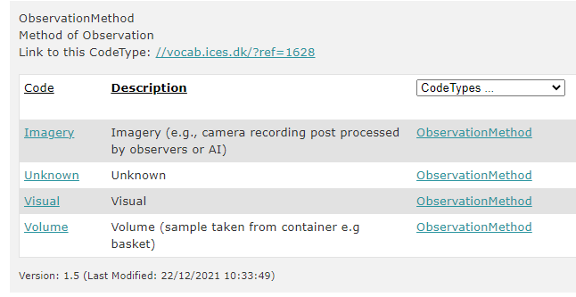
5. Some highlights of by-catch related potental of RDBES
Result Intersessional work with WGBYC members
  SSobservationType (SS table)

Slide 37
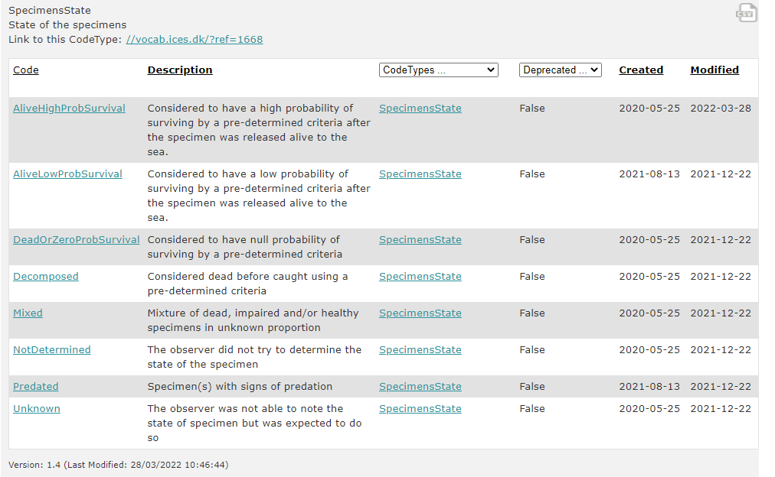
Some highlights of by-catch related potental of RDBES
SpecimenState (BV table)

Slide 38
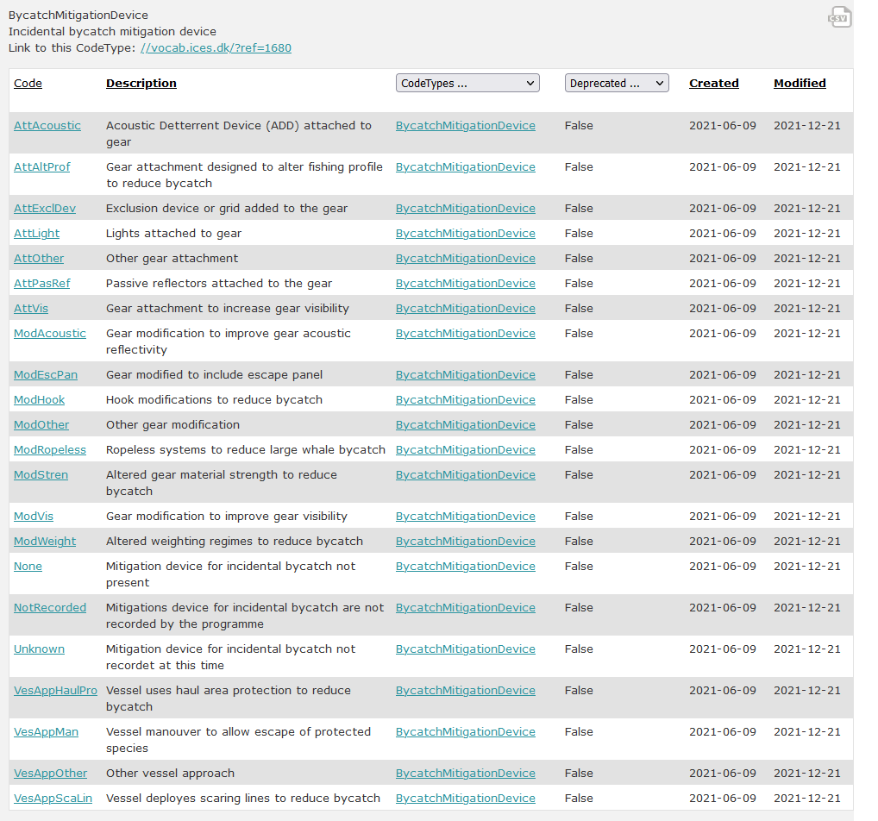
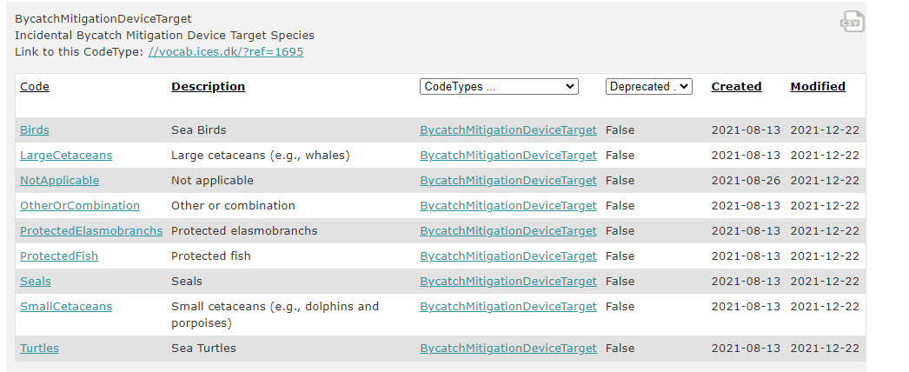
Some highlights of by-catch related potental of RDBES
Bycatch mitigation devices and targets (FO table)

Slide 39
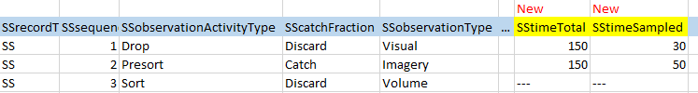
Some highlights of by-catch related potental of RDBES
Variables on time observed:

Slide 40
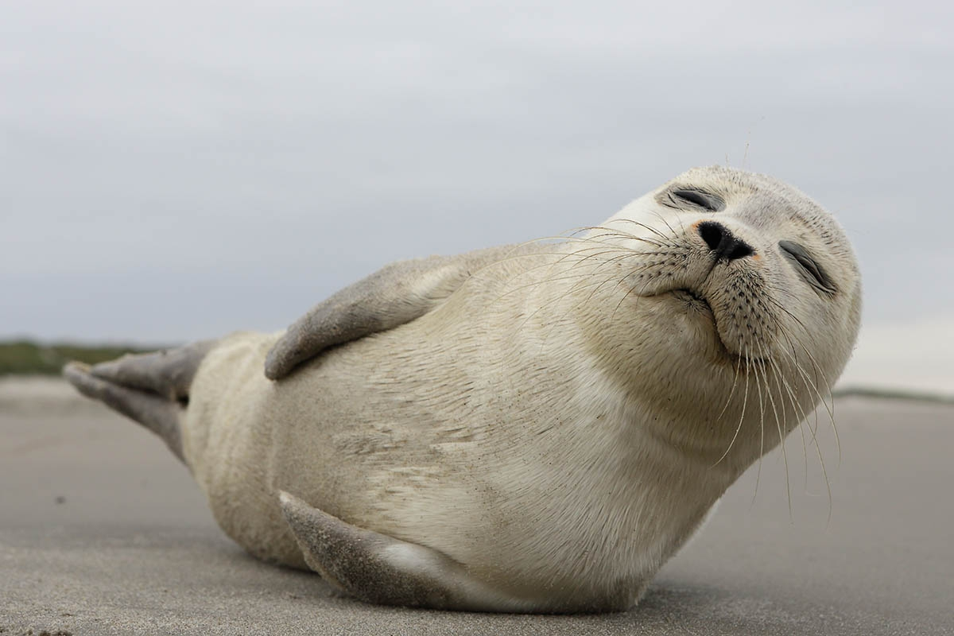
End: questions?
I like true zeros!
(they produce good forecasts on me)
Thank you!

